Slide 1

1
FUNCTIONS AND MODELS

Slide 2
FUNCTIONS AND MODELS
The fundamental objects
that we deal with in calculus
are functions.

Slide 3
FUNCTIONS AND MODELS
This chapter prepares the way
for calculus by discussing:
  The basic ideas concerning functions
  Their graphs
  Ways of transforming and combining them

Slide 4
FUNCTIONS AND MODELS
We stress that a function can be
represented in different ways:
  By an equation
  In a table
  By a graph
  In words

Slide 5
FUNCTIONS AND MODELS
In this chapter, we:
  Look at the main types of functions that occur
  in calculus
  Describe the process of using these functions as mathematical models of real-world phenomena
  Discuss the use of graphing calculators and
  graphing software for computers

Slide 6
FUNCTIONS AND MODELS
1.1
Four Ways to
Represent a Function
In this section, we will learn about:
The main types of functions that occur in calculus.

Slide 7
FOUR WAYS TO REPRESENT A FUNCTION
Functions arise whenever
one quantity depends on
another.
  Consider the following four situations.

Slide 8

EXAMPLE A
The area A of a circle depends
on the radius r of the circle.
  The rule that connects r and A is given by the
  equation .
  With each positive number r, there is associated
  one value of A, and we say that A is a function of r.

Slide 9
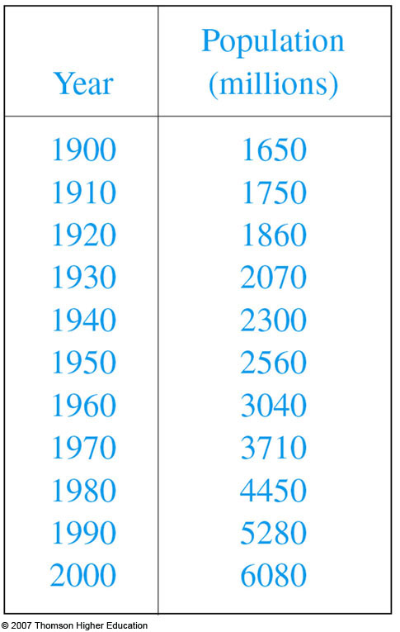

EXAMPLE B
The human population of the world
P depends on the time t.
  The table gives estimates of the
  world population P(t) at time t,
  for certain years.
  For instance,
  However, for each value of the
  time t, there is a corresponding
  value of P, and we say that
  P is a function of t.

Slide 10
EXAMPLE C
The cost C of mailing a first-class
letter depends on the weight w
of the letter.
  Although there is no simple formula that
  connects w and C, the post office has a rule
  for determining C when w is known.

Slide 11
EXAMPLE D
The vertical acceleration a of the
ground as measured by a seismograph
during an earthquake is a function of
the elapsed time t.

Slide 12
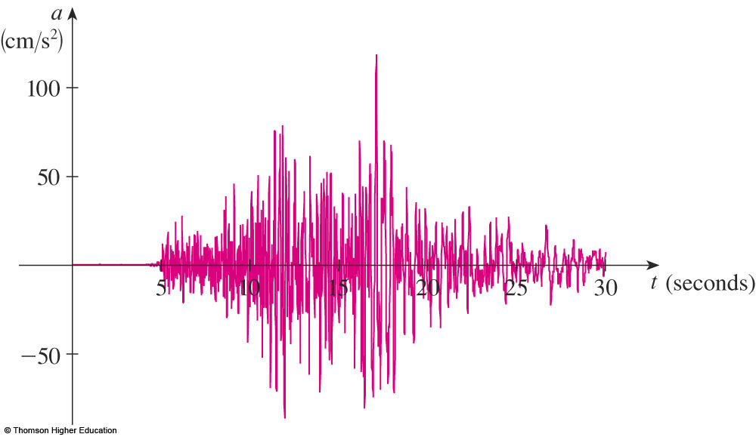
EXAMPLE D
The figure shows a graph generated by
seismic activity during the Northridge
earthquake that shook Los Angeles in 1994.
  For a given value of t, the graph provides
  a corresponding value of a.

Slide 13
FUNCTION
Each of these examples describes a rule
whereby, given a number (r, t, w, or t),
another number (A, P, C, or a) is
assigned.
  In each case, we say that the second number
  is a function of the first number.

Slide 14
FUNCTION
A function f is a rule that assigns to
each element x in a set D exactly
one element, called f(x), in a set E.

Slide 15
DOMAIN
We usually consider functions for
which the sets D and E are sets of
real numbers.
The set D is called the domain of the
function.

Slide 16
VALUE AND RANGE
The number f(x) is the value of f at x
and is read ‘f of x.’
The range of f is the set of all possible
values of f(x) as x varies throughout the
domain.

Slide 17
INDEPENDENT VARIABLE
A symbol that represents an arbitrary
number in the domain of a function f
is called an independent variable.
  For instance, in Example A, r is the independent variable.

Slide 18
DEPENDENT VARIABLE
A symbol that represents a number in
the range of f is called a dependent
variable.
  For instance, in Example A, A is the dependent variable.

Slide 19
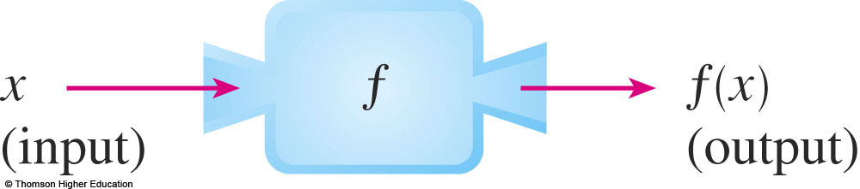
MACHINE
It’s helpful to think of a function
as a machine.
  If x is in the domain of the function f, then when x
  enters the machine, it’s accepted as an input and
  the machine produces an output f(x) according to
  the rule of the function.

Slide 20
MACHINE
  Thus, we can think of the domain as
  the set of all possible inputs and the range as the set of all possible outputs.

Slide 21

MACHINE
The preprogrammed functions in a
calculator are good examples of a
function as a machine.
  For example, the square root key on your calculator computes such a function.
  You press the key labeled and enter
  the input x.

Slide 22

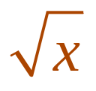
MACHINE
  If x < 0, then x is not in the domain of this function—that is, x is not an acceptable input,
  and the calculator will indicate an error.
  If , then an approximation to will appear
  in the display.
  Thus, the key on your calculator is not quite
  the same as the exact mathematical function f defined by f(x) = .

Slide 23
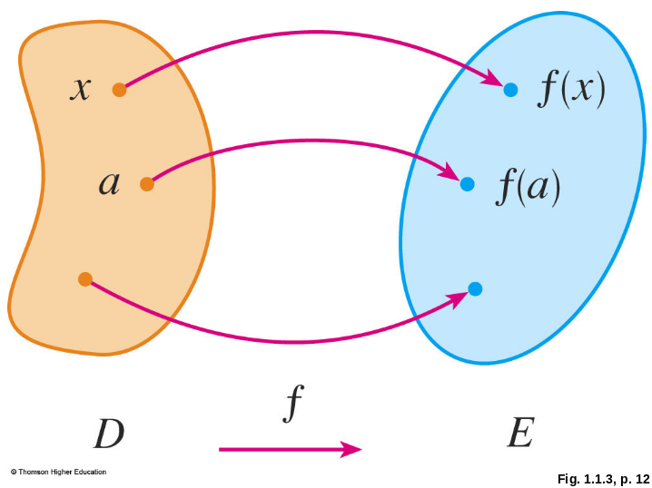
ARROW DIAGRAM
Another way to picture a function is
by an arrow diagram.
  Each arrow connects an element of D to
  an element of E.
  The arrow indicates that f(x) is associated with x,
  f(a) is associated with a,
  and so on.

Slide 24
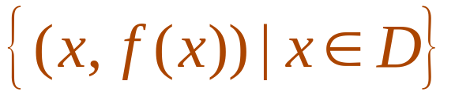
GRAPH
The most common method for
visualizing a function is its graph.
  If f is a function with domain D, then its graph is
  the set of ordered pairs
  Notice that these are input-output pairs.
  In other words, the graph of f consists of all points
  (x, y) in the coordinate plane such that y = f(x)
  and x is in the domain of f.

Slide 25
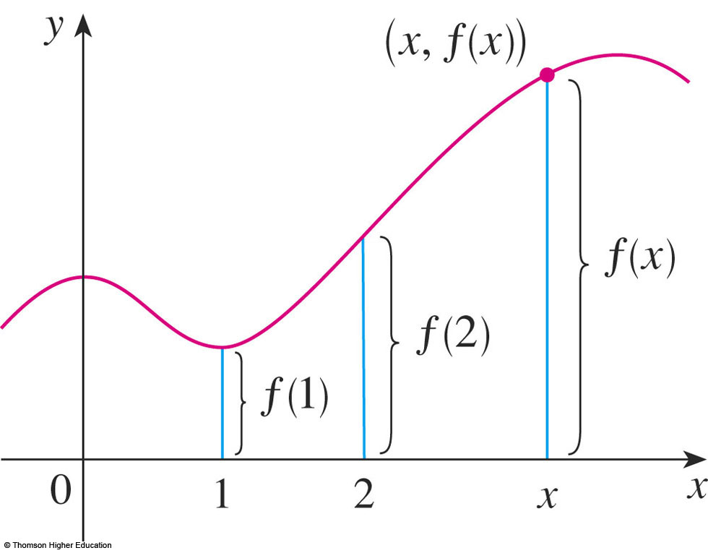
GRAPH
The graph of a function f gives us
a useful picture of the behavior or
‘life history’ of a function.
  Since the y-coordinate of any point (x, y) on
  the graph is y = f(x), we can read the value of f(x)
  from the graph as
  being the height of
  the graph above
  the point x.

Slide 26
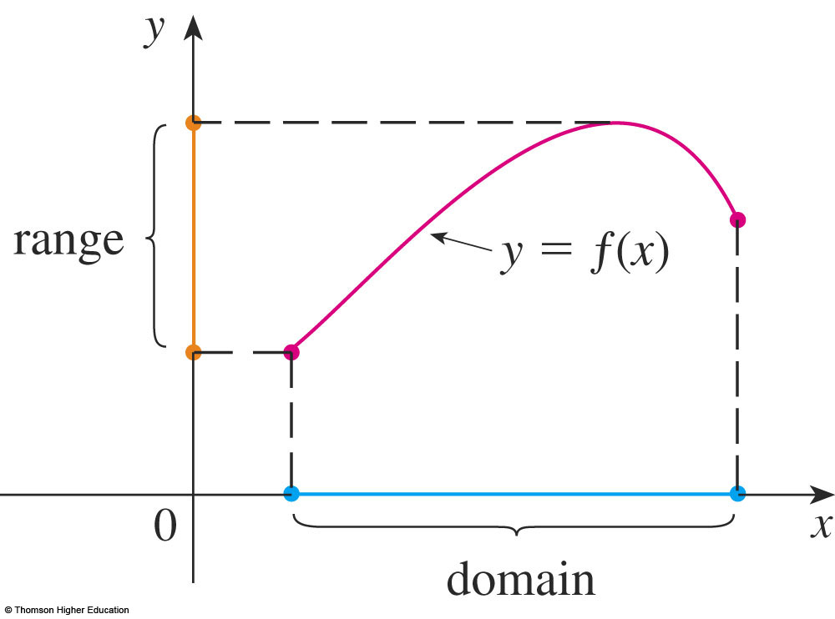
GRAPH
The graph of f also allows us
to picture:
  The domain of f on the x-axis
  Its range on the y-axis

Slide 27
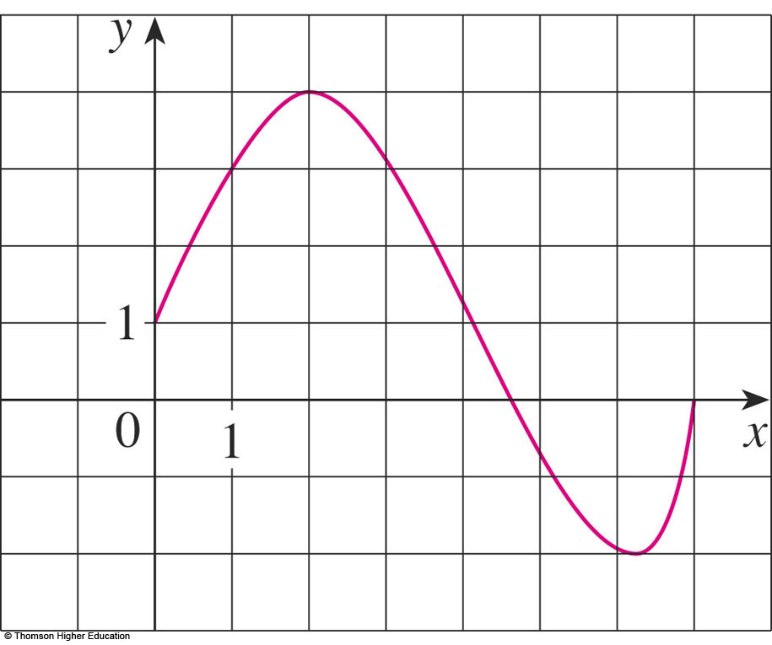
GRAPH
Example 1
The graph of a function f is shown.
Find the values of f(1) and f(5).
What is the domain and range of f ?

Slide 28

GRAPH
Example 1 a
We see that the point (1, 3) lies on
the graph of f.
  So, the value of f at 1 is f(1) = 3.
  In other words, the point on the graph that lies
  above x = 1 is 3 units
  above the x-axis.
  When x = 5, the graph
  lies about 0.7 units
  below the x-axis.
  So, we estimate that

Slide 29
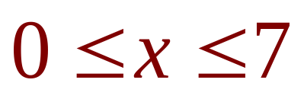
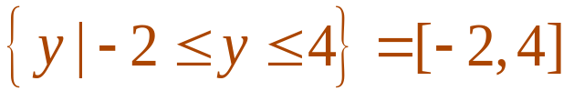
GRAPH
Example 1 b
We see that f(x) is defined when
.
  So, the domain of f is the closed interval [0, 7].
  Notice that f takes on all values from -2 to 4.
  So, the range of f is

Slide 30
GRAPH
Example 2
Sketch the graph and find the
domain and range of each function.
f(x) = 2x – 1
g(x) = x²

Slide 31
GRAPH
Example 2 a
The equation of the graph is:
y = 2x – 1
  We recognize this as being the equation of a line
  with slope 2 and y-intercept -1.
  Recall the slope-intercept form of the equation of
  a line: y = mx + b.
  This enables us to sketch a portion of the graph of f,
  as follows.

Slide 32

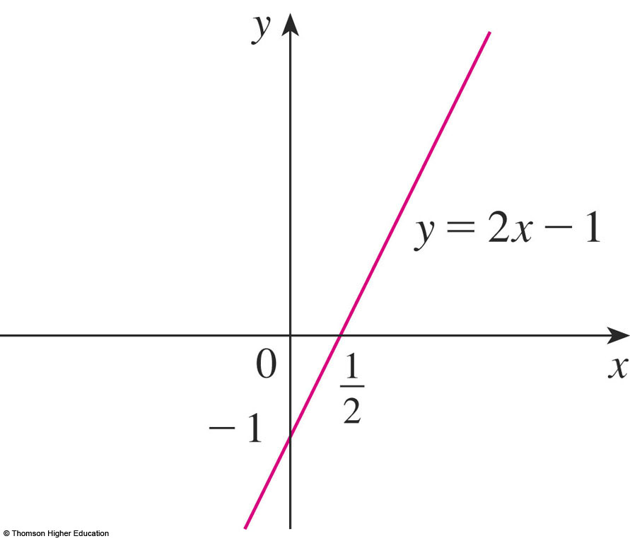

GRAPH
Example 2 a
The expression 2x - 1 is defined for
all real numbers.
  So, the domain of f is the set of all real numbers,
  which we denote by .
  The graph shows that the range is also .

Slide 33
GRAPH
Example 2 b
Since g(2) = 2² = 4 and g(-1) = (-1)² = 1,
we could plot the points (2, 4) and (-1, 1),
together with a few other points on the graph,
and join them to produce the next graph.

Slide 34
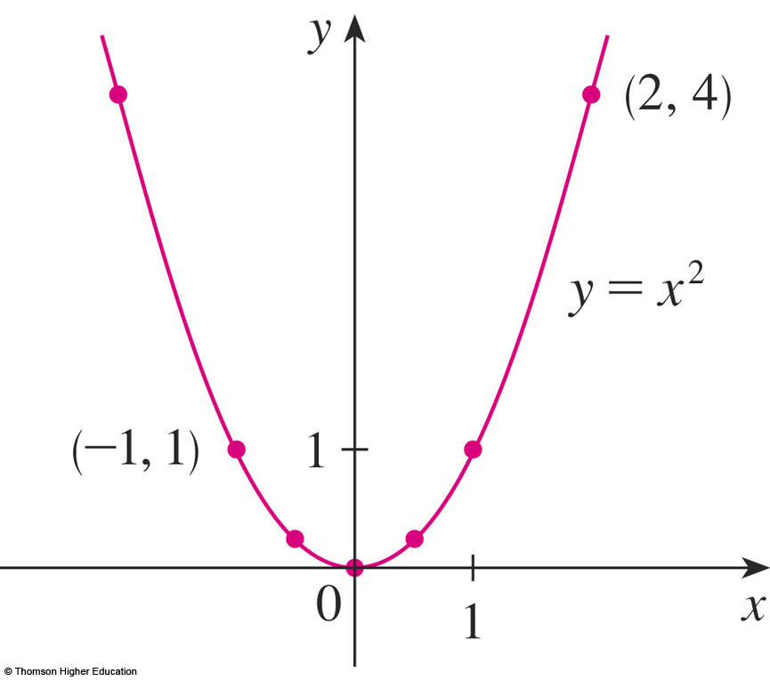
GRAPH
Example 2 b
The equation of the graph is y = x²,
which represents a parabola.
The domain of g is .

Slide 35

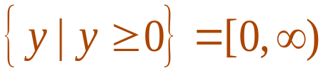
GRAPH
Example 2 b
The range of g consists of all values of
g(x), that is, all numbers of the form x².
  However, for all numbers x, and any positive number y is a square.
  So, the range of g is
  This can also be seen
  from the figure.

Slide 36
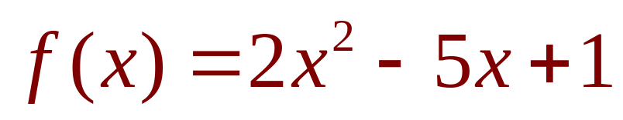
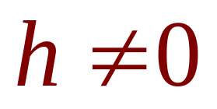
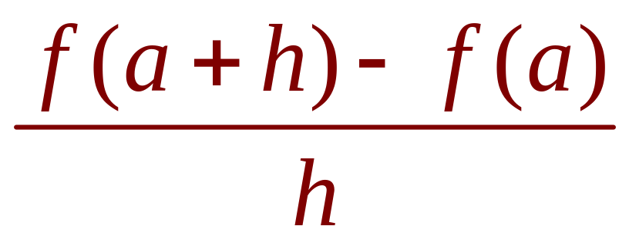
FUNCTIONS
Example 3
If and ,
evaluate:

Slide 37
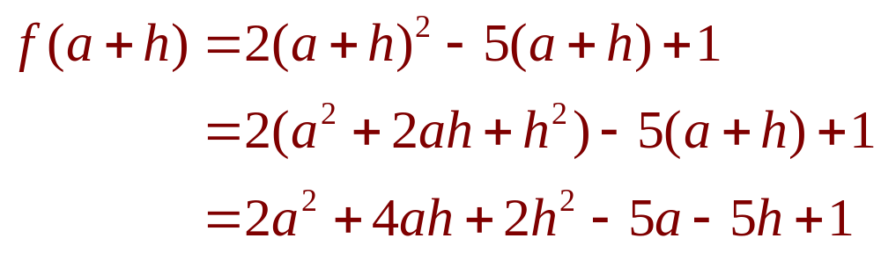
FUNCTIONS
Example 3
First, we evaluate f(a + h) by replacing x
by a + h in the expression for f(x):

Slide 38
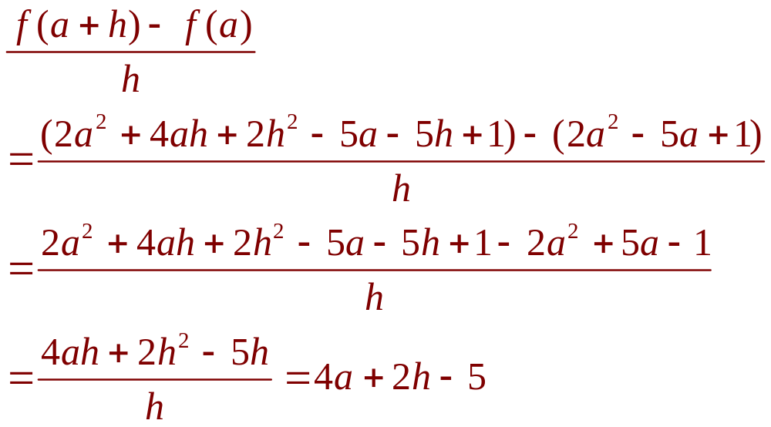
FUNCTIONS
Example 3
Then, we substitute it into the given
expression and simplify:

Slide 39
REPRESENTATIONS OF FUNCTIONS
There are four possible ways to
represent a function:
  Verbally (by a description in words)
  Numerically (by a table of values)
  Visually (by a graph)
  Algebraically (by an explicit formula)

Slide 40
REPRESENTATIONS OF FUNCTIONS
If a single function can be represented
in all four ways, it’s often useful to go
from one representation to another to
gain additional insight into the function.
  For instance, in Example 2, we started with
  algebraic formulas and then obtained the graphs.

Slide 41
REPRESENTATIONS OF FUNCTIONS
However, certain functions are
described more naturally by one
method than by another.
  With this in mind, let’s reexamine the four situations
  that we considered at the beginning of this section.

Slide 42
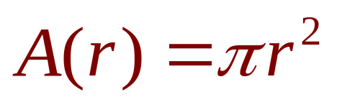
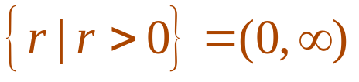

SITUATION A
The most useful representation of
the area of a circle as a function of
its radius is probably the algebraic
formula .
  However, it is possible to compile a table of values
  or to sketch a graph (half a parabola).
  As a circle has to have a positive radius, the domain
  is , and the range is also (0, ).

Slide 43
SITUATION B
We are given a description of the
function in words:
P(t) is the human population of the world
at time t.
  The table of values of world
  population provides a
  convenient representation of
  this function.
  If we plot these values, we get
  a graph as follows.

Slide 44
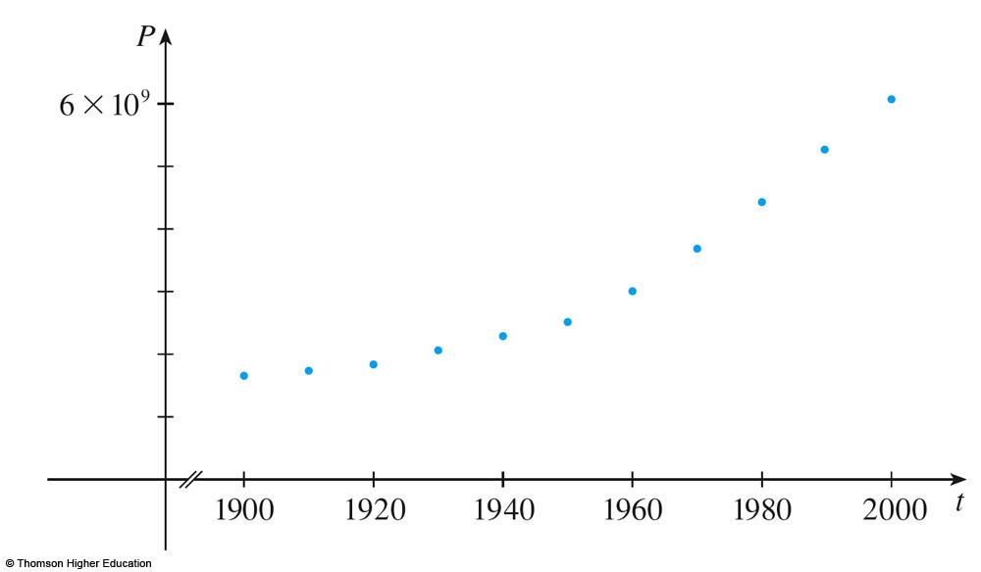
SITUATION B
This graph is called a scatter plot.
  It too is a useful representation.
  It allows us to absorb all the data at once.

Slide 45
SITUATION B
What about a formula?
  Of course, it’s impossible to devise an explicit formula that gives the exact human population P(t) at any time t.
  However, it is possible to find an expression for
  a function that approximates P(t).

Slide 46
SITUATION B
In fact, using methods explained in
Section 1.2, we obtain the approximation:

Slide 47
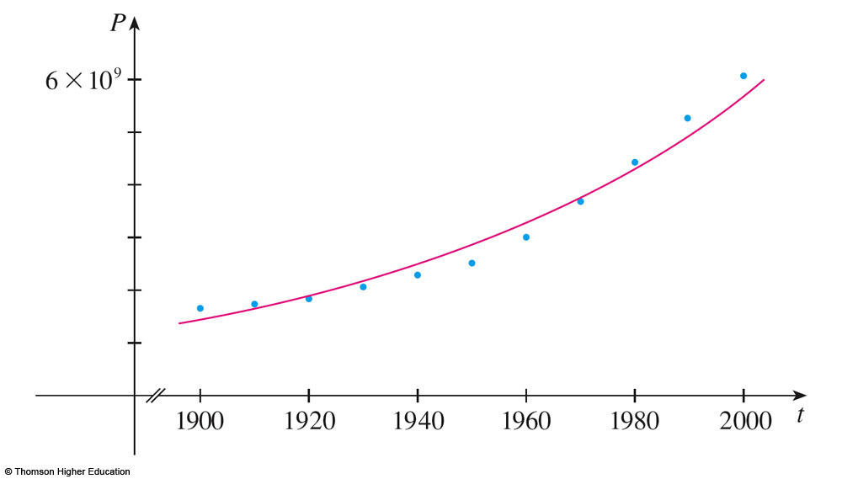
SITUATION B
This figure shows that the
approximation is a reasonably
good ‘fit.’

Slide 48
SITUATION B
The function f is called a mathematical
model for population growth.
  In other words, it is a function with an explicit
  formula that approximates the behavior of our
  given function.
  However, we will see that the ideas of calculus
  can be applied to a table of values.
  An explicit formula is not necessary.

Slide 49
SITUATION B
The function P is typical of the functions
that arise whenever we attempt to apply
calculus to the real world.
  We start with a verbal description of a function.
  Then, we may be able to construct a table of values
  of the function—perhaps from instrument readings
  in a scientific experiment.

Slide 50
SITUATION B
  Even though we don’t have complete knowledge of the values of the function,
  we will see throughout the book that it is
  still possible to perform the operations of calculus on such a function.

Slide 51
SITUATION C
Again, the function is described in
words:
  C(w) is the cost of mailing a first-class letter with
  weight w.
The rule that the US Postal Service
used as of 2006 is:
  The cost is 39 cents for up to one ounce, plus 24 cents for each successive ounce up to 13 ounces.

Slide 52
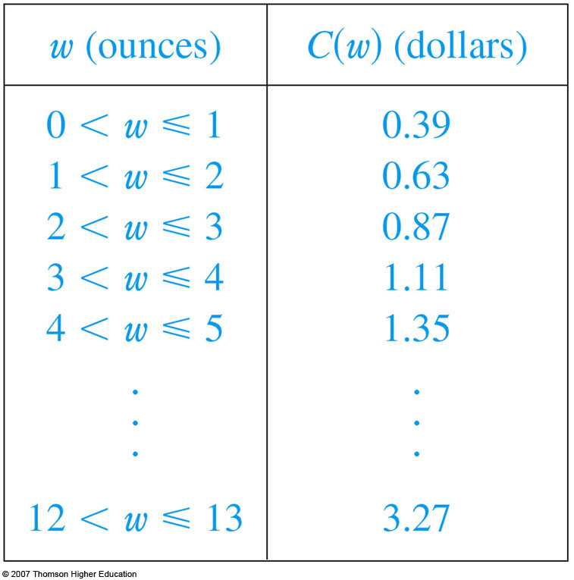
SITUATION C
The table of values shown is the
most convenient representation for
this function.
  However, it is possible
  to sketch a graph.
  (See Example 10.)

Slide 53
SITUATION D
The graph shown is the most
natural representation of the vertical
acceleration function a(t).

Slide 54
SITUATION D
It’s true that a table of values could
be compiled.
It is even possible to devise an
approximate formula.

Slide 55
SITUATION D
However, everything a geologist needs to
know—amplitudes and patterns—can be
seen easily from the graph.
  The same is true for the patterns seen in electrocardiograms of heart patients and polygraphs
  for lie-detection.

Slide 56
REPRESENTATIONS
In the next example, we sketch the
graph of a function that is defined
verbally.

Slide 57
REPRESENTATIONS
Example 4
When you turn on a hot-water faucet, the
temperature T of the water depends on how
long the water has been running.
Draw a rough graph of T as a function of
the time t that has elapsed since the faucet
was turned on.

Slide 58
REPRESENTATIONS
Example 4
The initial temperature of the running water
is close to room temperature—because the
water has been sitting in the pipes.
When the water from the hot-water tank starts
flowing from the faucet, T increases quickly.
Notes:
s

Slide 59
REPRESENTATIONS
Example 4
In the next phase, T is constant at the
temperature of the heated water in the tank.
When the tank is drained, T decreases to
the temperature of the water supply.

Slide 60
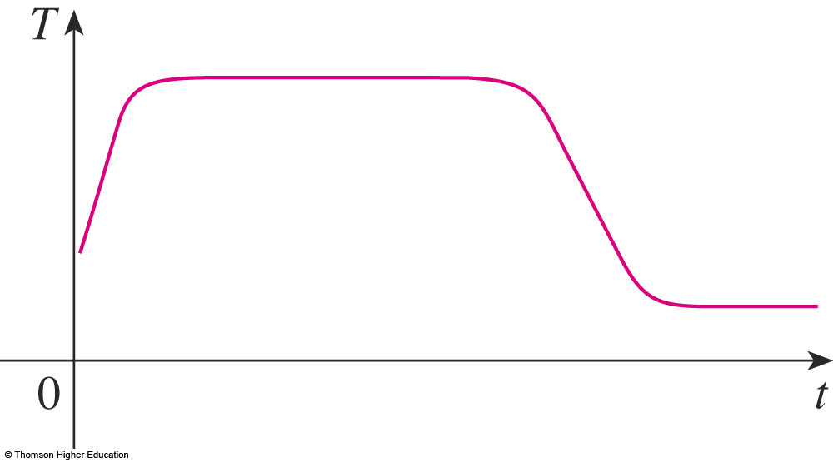
REPRESENTATIONS
Example 4
This enables us to make the rough
sketch of T as a function of t.

Slide 61
REPRESENTATIONS
In the following example, we start with
a verbal description of a function in
a physical situation and obtain an explicit
algebraic formula.
  The ability to do this is a useful skill in solving calculus problems that ask for the maximum or minimum values of quantities.

Slide 62
REPRESENTATIONS
Example 5
A rectangular storage container with an
open top has a volume of 10 m³.
  The length of its base is twice its width.
  Material for the base costs $10 per square meter.
  Material for the sides costs $6 per square meter.
Express the cost of materials as a
function of the width of the base.

Slide 63
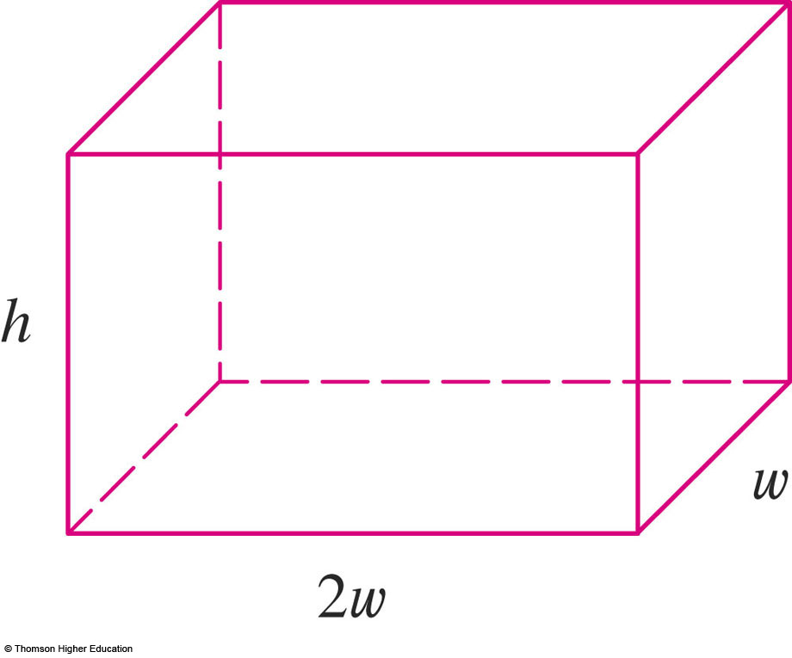
REPRESENTATIONS
Example 5
We draw a diagram and introduce notation—
by letting w and 2w be the width and length of
the base, respectively, and h be the height.

Slide 64
REPRESENTATIONS
Example 5
The area of the base is (2w)w = 2w².
So, the cost, in dollars, of the material
for the base is 10(2w²).

Slide 65
REPRESENTATIONS
Example 5
Two of the sides have an area wh and
the other two have an area 2wh.
So, the cost of the material for the sides is
6[2(wh) + 2(2wh)].

Slide 66
REPRESENTATIONS
Example 5
Therefore, the total cost is:

Slide 67
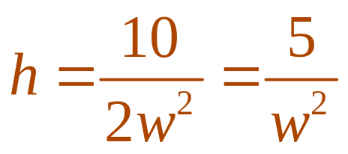
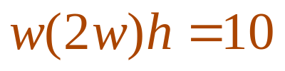
REPRESENTATIONS
Example 5
To express C as a function of w alone,
we need to eliminate h.
We do so by using the fact that the
volume is 10 m³.
  Thus, , which gives

Slide 68
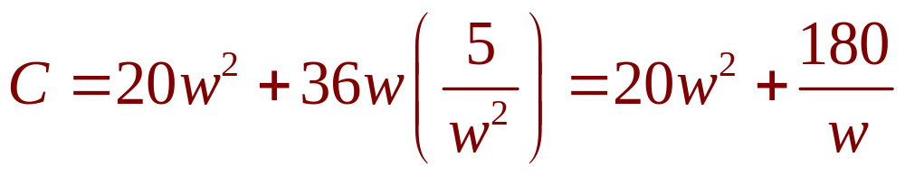
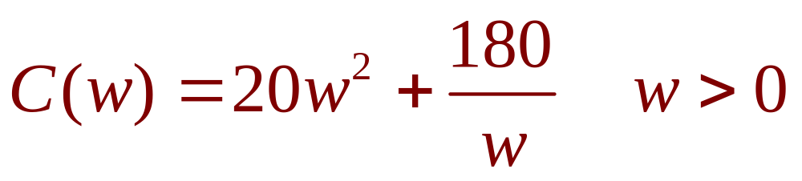
REPRESENTATIONS
Example 5
Substituting that into the expression for C,
we have:
Therefore, the equation
expresses C as a function of w.

Slide 69
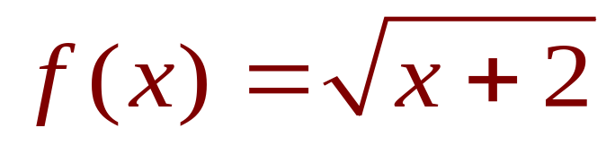
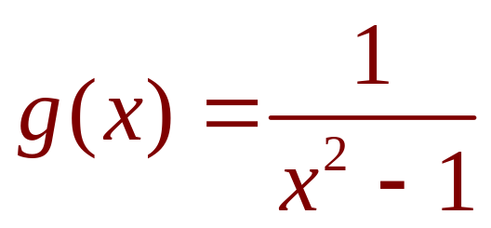
REPRESENTATIONS
Example 6
Find the domain of each function.
a.
b.

Slide 70
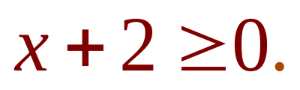


REPRESENTATIONS
Example 6 a
The square root of a negative number is
not defined (as a real number).
So, the domain of f consists of all values
of x such that
  This is equivalent to .
  So, the domain is the interval .

Slide 71
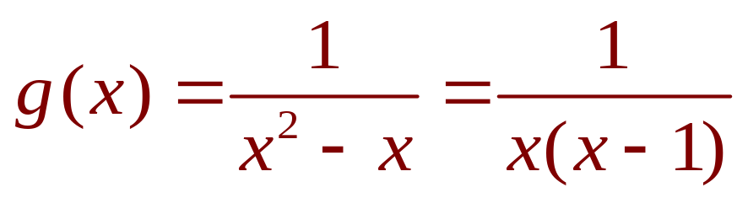
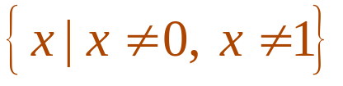

REPRESENTATIONS
Example 6 b
Since
and division by 0 is not allowed, we see
that g(x) is not defined when x = 0 or
x = 1.
  Thus, the domain of g is .
  This could also be written in interval notation
  as .

Slide 72
REPRESENTATIONS
The graph of a function is a curve in
the xy-plane.
However, the question arises:
  Which curves in the xy-plane are graphs of functions?

Slide 73
THE VERTICAL LINE TEST
A curve in the xy-plane is the graph
of a function of x if and only if no
vertical line intersects the curve more
than once.

Slide 74
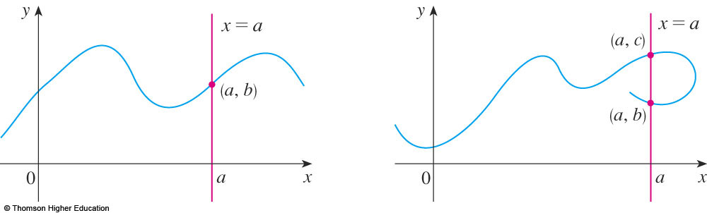
THE VERTICAL LINE TEST
The reason for the truth of the Vertical
Line Test can be seen in the figure.

Slide 75
THE VERTICAL LINE TEST
If each vertical line x = a intersects a curve
only once—at (a, b)—then one functional
value is defined by f(a) = b.

Slide 76
THE VERTICAL LINE TEST
However, if a line x = a intersects the curve
twice—at (a, b) and (a, c)—then the curve
can’t represent a function because a function
can’t assign two different values to a.

Slide 77
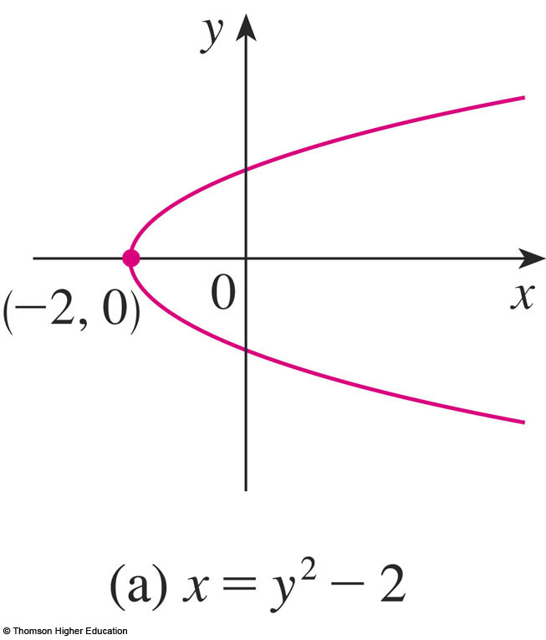
THE VERTICAL LINE TEST
For example, the parabola x = y² – 2
shown in the figure is not the graph of
a function of x.
  This is because there are
  vertical lines that intersect
  the parabola twice.
  The parabola, however,
  does contain the graphs
  of two functions of x.

Slide 78
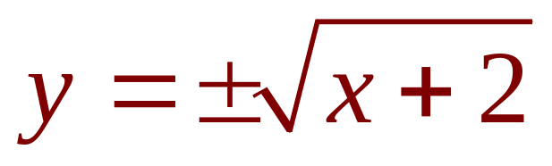
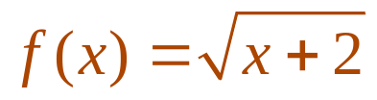
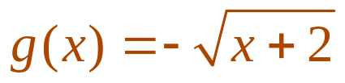
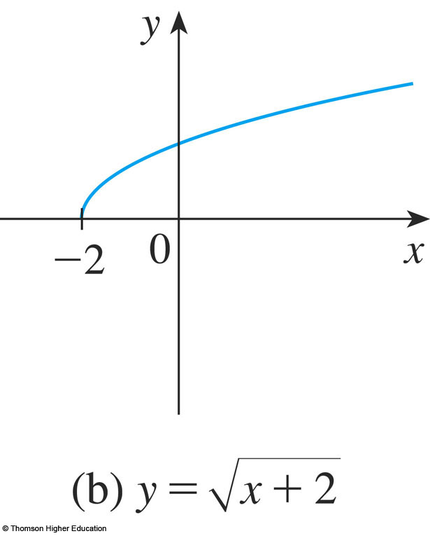
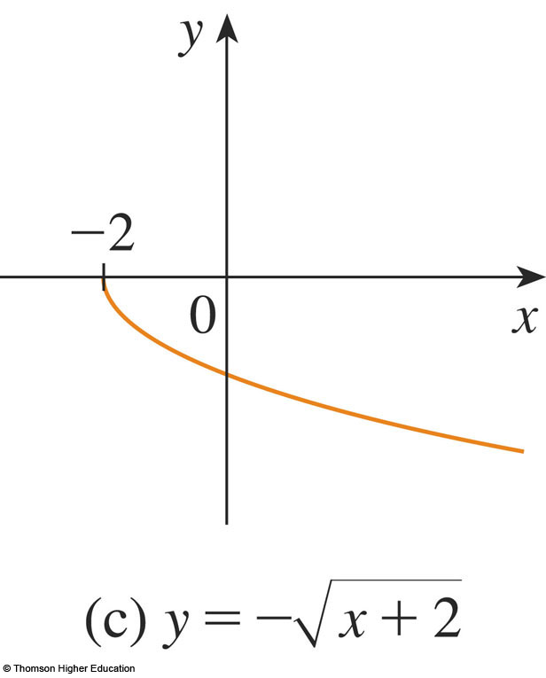
THE VERTICAL LINE TEST
Notice that the equation x = y² - 2
implies y² = x + 2, so
  So, the upper and lower halves of the parabola
  are the graphs of the functions
  and

Slide 79
THE VERTICAL LINE TEST
If we reverse the roles of x and y,
then:
  The equation x = h(y) = y² - 2 does define x as
  a function of y (with y as the independent variable
  and x as the dependent variable).
  The parabola appears as
  the graph of the function h.

Slide 80
PIECEWISE-DEFINED FUNCTIONS
The functions in the following four
examples are defined by different formulas
in different parts of their domains.

Slide 81
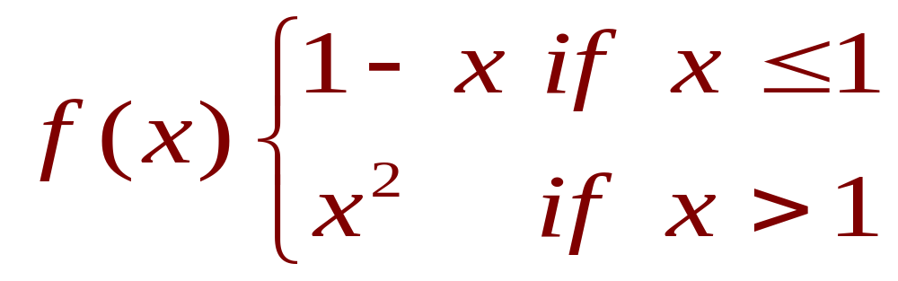
PIECEWISE-DEFINED FUNCTIONS
Example 7
A function f is defined by:
Evaluate f(0), f(1), and f(2) and
sketch the graph.

Slide 82

PIECEWISE-DEFINED FUNCTIONS
Example 7
Remember that a function is a rule.
For this particular function, the rule is:
  First, look at the value of the input x.
  If it happens that , then the value of f(x) is 1 - x.
  In contrast, if x > 1, then the value of f(x) is x².

Slide 83

PIECEWISE-DEFINED FUNCTIONS
Example 7
Thus,
  Since 0 1, we have f(0) = 1 - 0 = 1.
  Since 1 1, we have f(1) = 1 - 1 = 0.
  Since 2 > 1, we have f(2) = 2² = 4.

Slide 84
PIECEWISE-DEFINED FUNCTIONS
Example 7
How do we draw the graph of f ?
  If , then f(x) = 1 – x.
  So, the part of the graph of f that lies to the left of
  the vertical line x = 1 must coincide with the line
  y = 1 - x, which has slope -1 and y-intercept 1.
  If x > 1, then f(x) = x².
  So, the part of the graph of f that lies to the right of
  the line x = 1 must coincide with the graph of y = x²,
  which is a parabola.
  This enables us to sketch the graph as follows.

Slide 85
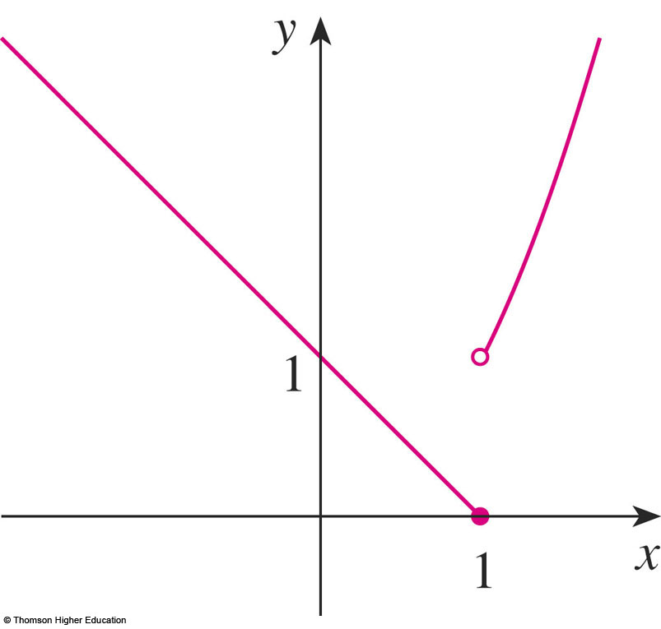
PIECEWISE-DEFINED FUNCTIONS
Example 7
The solid dot indicates that the point (1, 0)
is included on the graph.
The open dot indicates that the point (1, 1)
is excluded from the graph.

Slide 86



PIECEWISE-DEFINED FUNCTIONS
The next example is the absolute
value function.
  Recall that the absolute value of a number a,
  denoted by |a|, is the distance from a to 0 on
  the real number line.
  Distances are always positive or 0.
  So, we have for every number a.
  For example,
  |3| = 3 , |-3| = 3 , |0| = 0 , ,

Slide 87
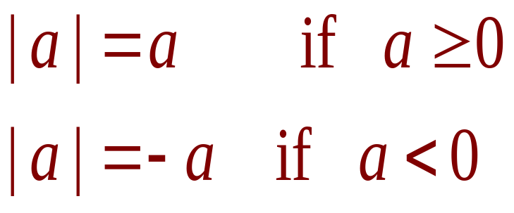
PIECEWISE-DEFINED FUNCTIONS
In general, we have:
  Remember that, if a is negative, then -a is positive.

Slide 88
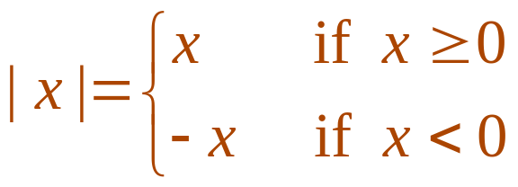
PIECEWISE-DEFINED FUNCTIONS
Example 8
Sketch the graph of the absolute
value function f(x) = |x|.
  From the preceding discussion,
  we know that:

Slide 89
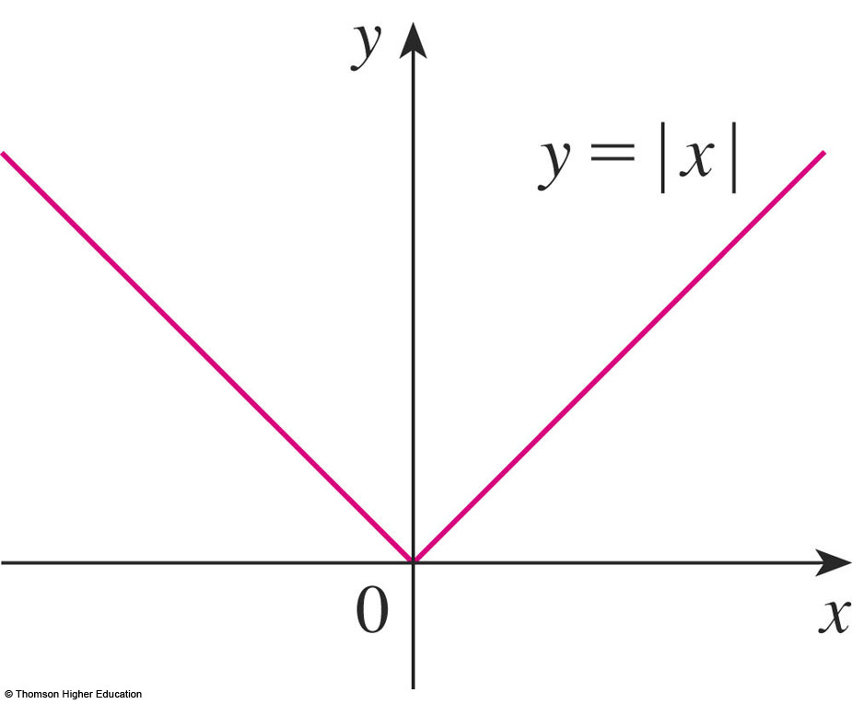
PIECEWISE-DEFINED FUNCTIONS
Example 8
Using the same method as in
Example 7, we see that the graph of f
coincides with:
  The line y = x to the right of the y-axis
  The line y = -x to the left of the y-axis

Slide 90
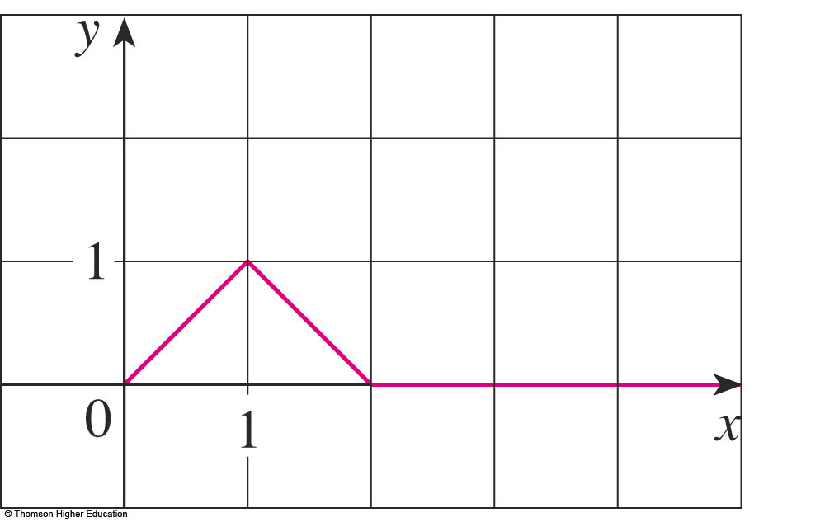
PIECEWISE-DEFINED FUNCTIONS
Example 9
Find a formula for the function f
graphed in the figure.

Slide 91

PIECEWISE-DEFINED FUNCTIONS
Example 9
The line through (0, 0) and (1, 1) has slope
m = 1 and y-intercept b = 0.
So, its equation is y = x.
  Thus, for the part of
  the graph of f that
  joins (0, 0) to (1, 1),
  we have:

Slide 92

PIECEWISE-DEFINED FUNCTIONS
Example 9
The line through (1, 1) and (2, 0) has slope
m = -1.
So, its point-slope form is y – 0 = (-1)(x - 2) or
y = 2 – x.
  So, we have:

Slide 93
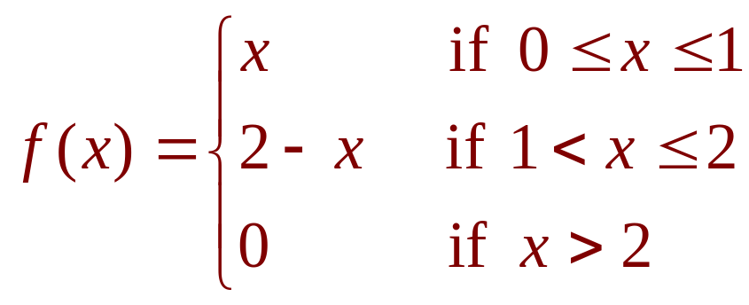
PIECEWISE-DEFINED FUNCTIONS
Example 9
We also see that the graph of f coincides with
the x-axis for x > 2.
Putting this information together, we have
the following three-piece formula for f:

Slide 94
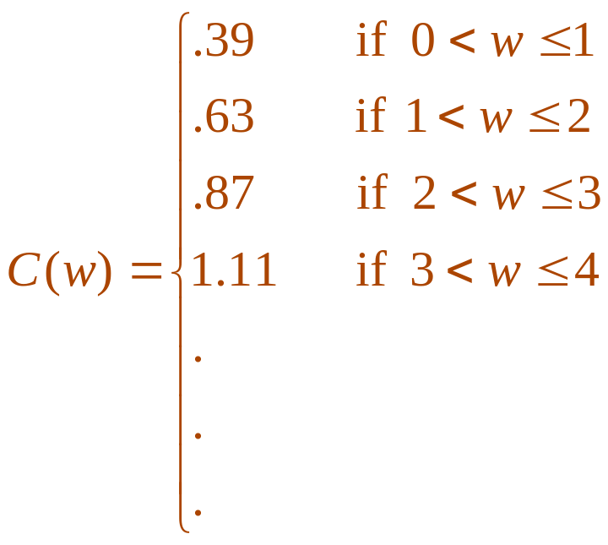
PIECEWISE-DEFINED FUNCTIONS
Example 10
In Example C, at the beginning of the section,
we considered the cost C(w) of mailing
a first-class letter with weight w.
  In effect, this is a piecewise-defined function because, from the table of values, we have:

Slide 95

PIECEWISE-DEFINED FUNCTIONS
Example 10
The graph is shown here.
You can see why functions like this are called
step functions—they jump from one value
to the next.
  You will study such
  functions in Chapter 2.

Slide 96
SYMMETRY: EVEN FUNCTION
If a function f satisfies f(-x) = f(x) for
every number x in its domain, then f
is called an even function.
  For instance, the function f(x) = x² is even
  because f(-x) = (-x)² = x² = f(x)

Slide 97


SYMMETRY: EVEN FUNCTION
The geometric significance of an even
function is that its graph is symmetric with
respect to the y–axis.
  This means that, if we
  have plotted the graph of f
  for , we obtain
  the entire graph simply
  by reflecting this portion
  about the y-axis.

Slide 98
SYMMETRY: ODD FUNCTION
If f satisfies f(-x) = -f(x) for every
number x in its domain, then f is called
an odd function.
  For example, the function f(x) = x³ is odd
  because f(-x) = (-x)³ = -x³ = -f(x)

Slide 99


SYMMETRY: ODD FUNCTION
The graph of an odd function is
symmetric about the origin.
  If we already have the graph of f for ,
  we can obtain the entire graph by rotating
  this portion through 180° about the origin.

Slide 100
SYMMETRY
Example 11
Determine whether each of these functions
is even, odd, or neither even nor odd.
f(x) = x⁵ + x
g(x) = 1 - x⁴
h(x) = 2x - x²

Slide 101


SYMMETRY
Example 11 a
Thus, f is an odd function.

Slide 102


SYMMETRY
Example 11 b
So, g is even.

Slide 103



SYMMETRY
Example 11 c
Since h(-x) h(x) and h(-x) -h(x),
we conclude that h is neither even nor odd.

Slide 104

SYMMETRY
Example 11
The graphs of the functions in the
example are shown.
  The graph of h is symmetric neither about the y-axis
  nor about the origin.

Slide 105

INCREASING AND DECREASING FUNCTIONS
This graph rises from A to B, falls from
B to C, and rises again from C to D.

Slide 106
INCREASING AND DECREASING FUNCTIONS
The function f is said to be increasing on
the interval [a, b], decreasing on [b, c], and
increasing again on [c, d].

Slide 107
INCREASING AND DECREASING FUNCTIONS
Notice that, if x₁and x₂ are any two numbers
between a and b with x₁ < x₂, then f(x₁) < f(x₂).
  We use this as the defining property of
  an increasing function.

Slide 108
INCREASING AND DECREASING FUNCTIONS
A function f is called increasing on
an interval I if:
f(x₁) < f(x₂) whenever x₁ < x₂ in I
It is called decreasing on I if:
f(x₁) > f(x₂) whenever x₁ < x₂ in I

Slide 109
INCREASING FUNCTION
In the definition of an increasing function,
it is important to realize that the inequality
f(x₁) < f(x₂) must be satisfied for every pair of
numbers x₁ and x₂ in I with x₁ < x₂.

Slide 110



INCREASING AND DECREASING FUNCTIONS
You can see from the figure that the function
f(x) = x² is decreasing on the interval
and increasing on the interval .

